Slide 1




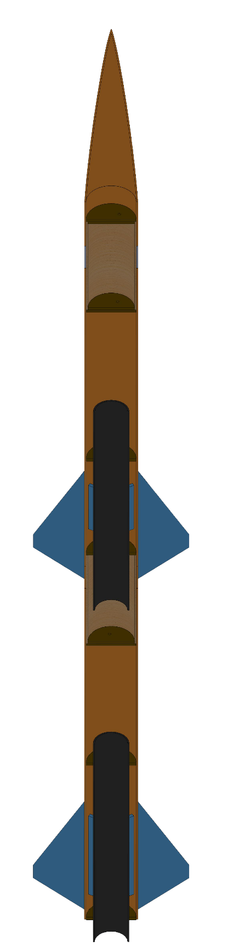
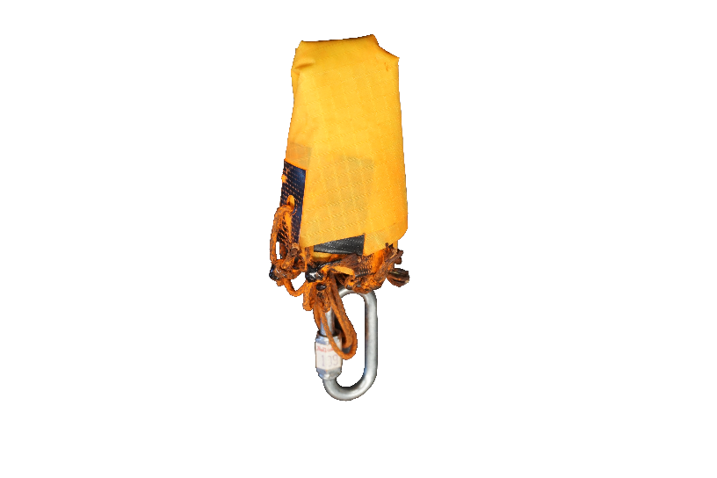
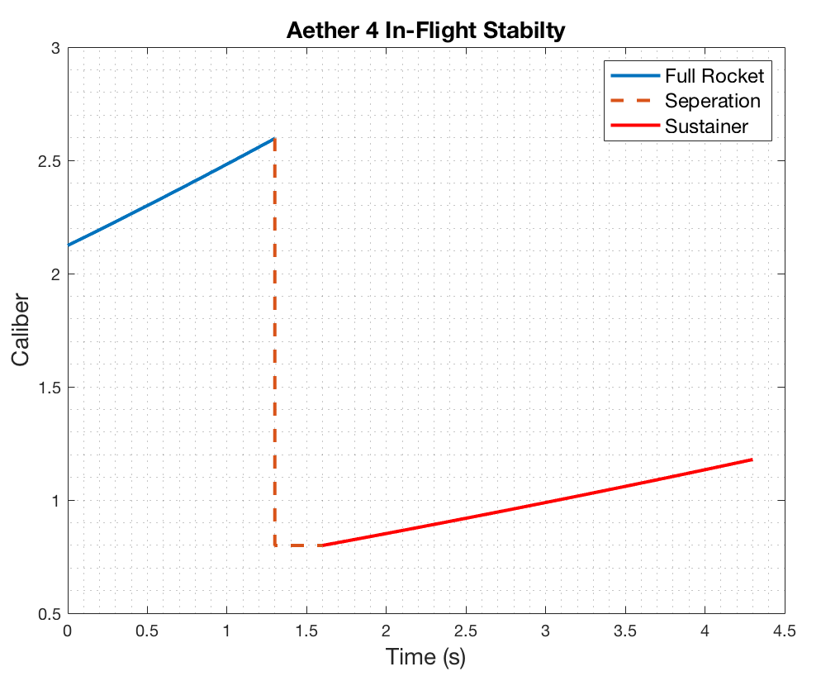
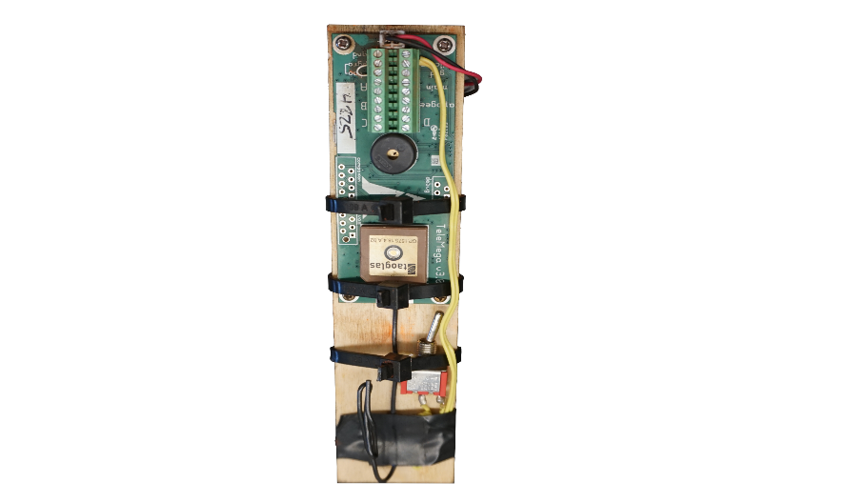
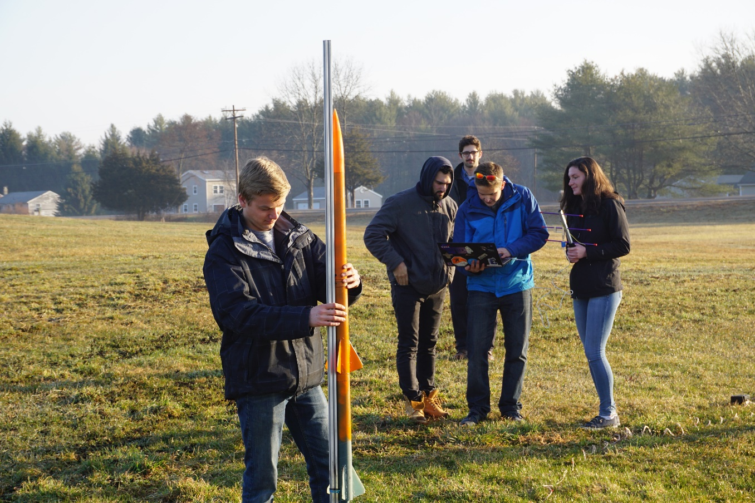
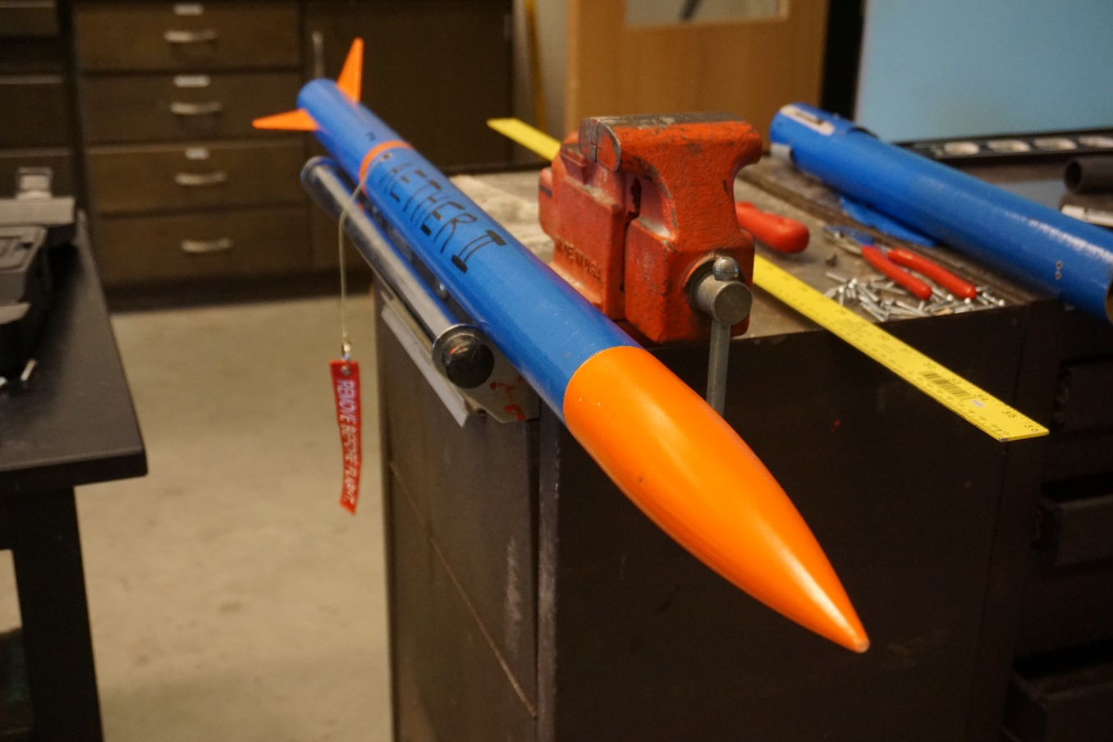
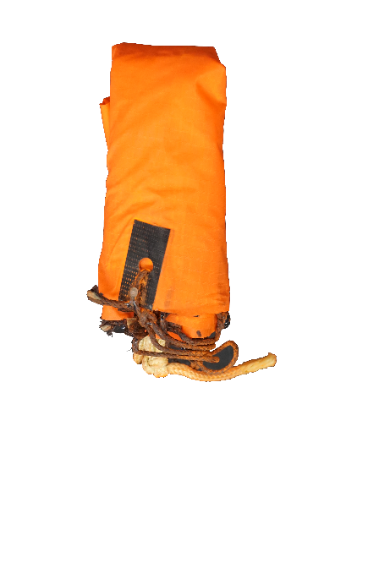
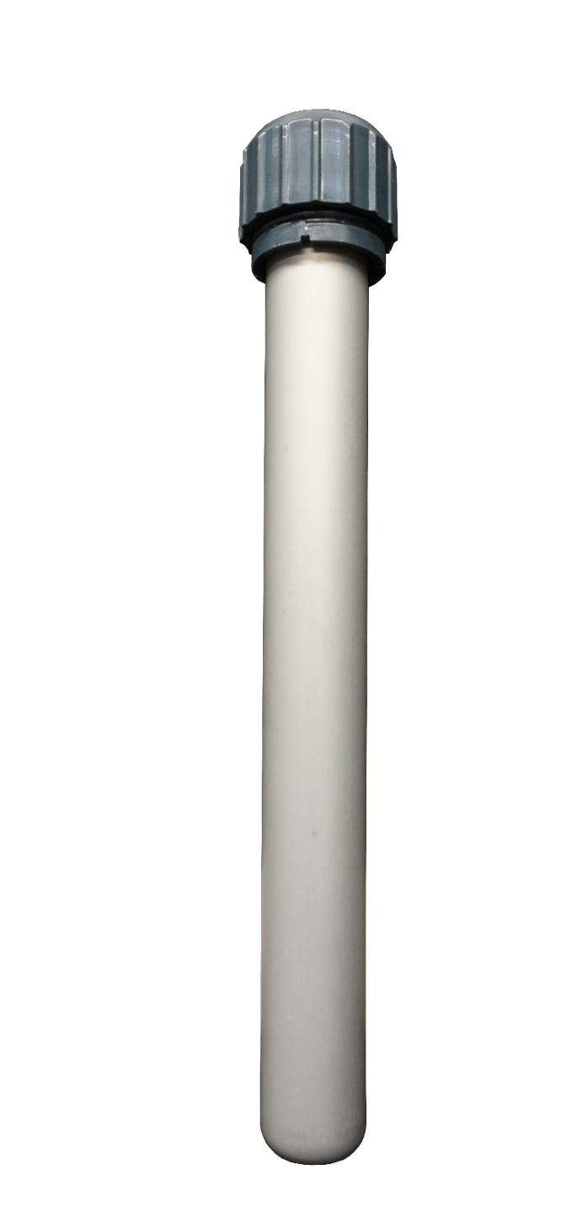
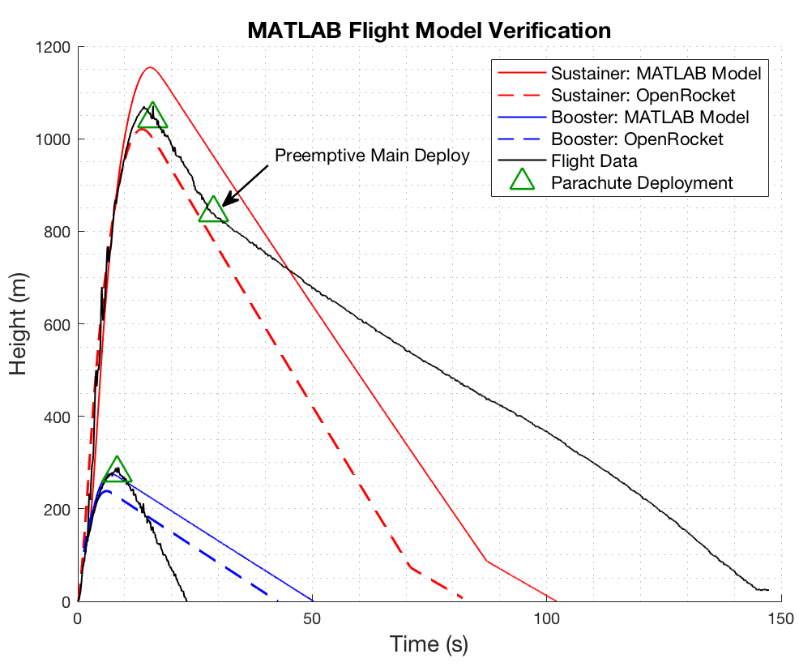
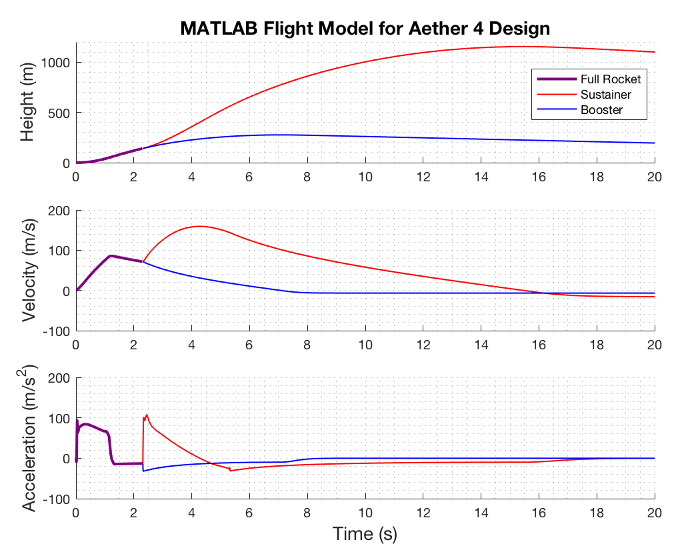
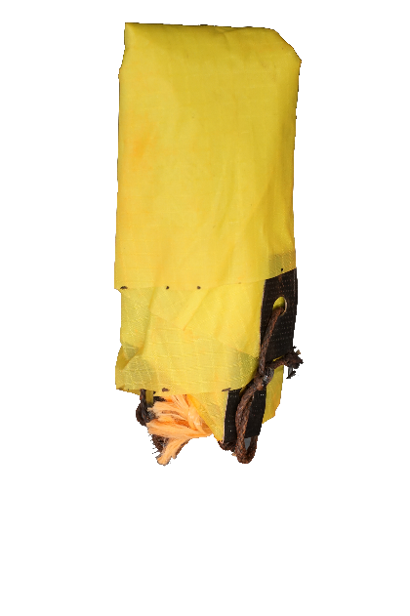

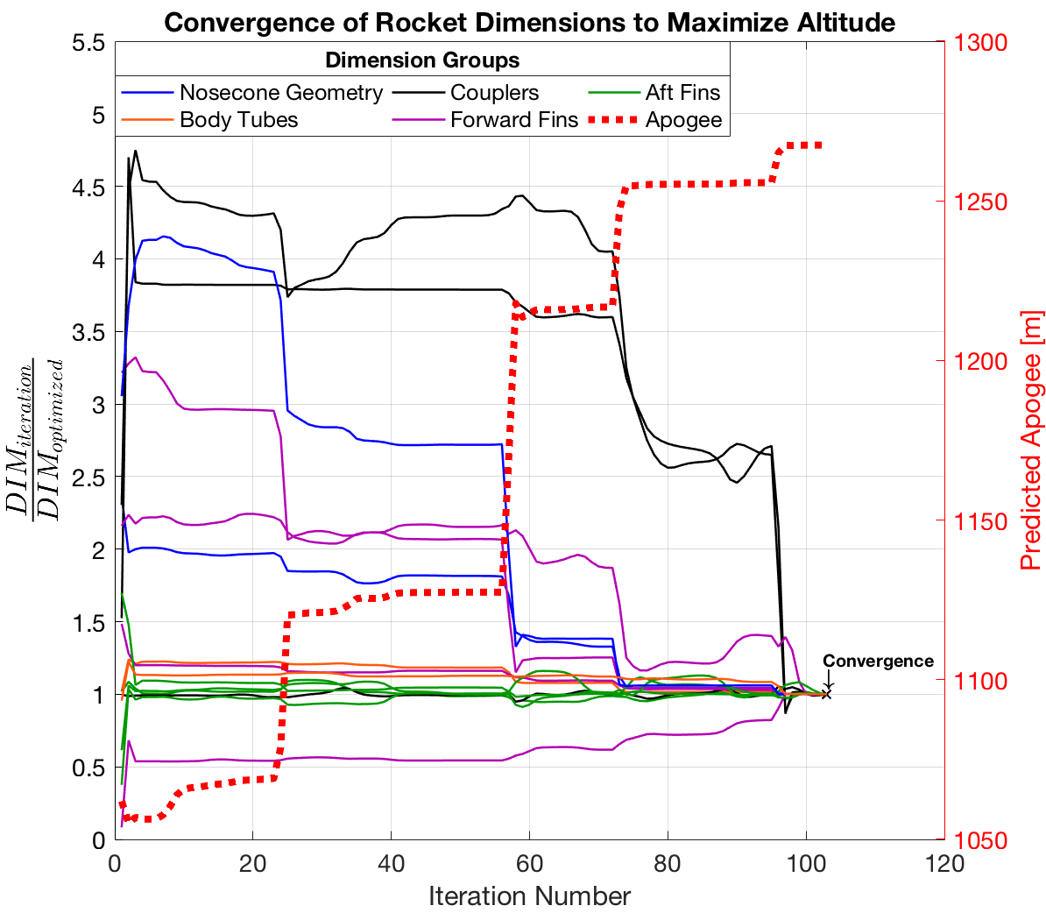
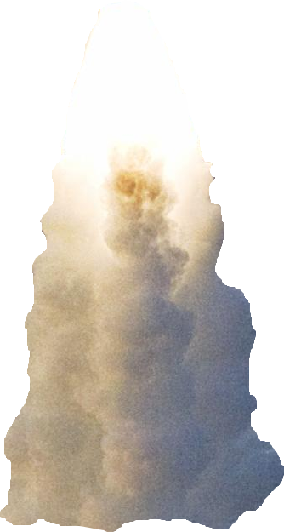
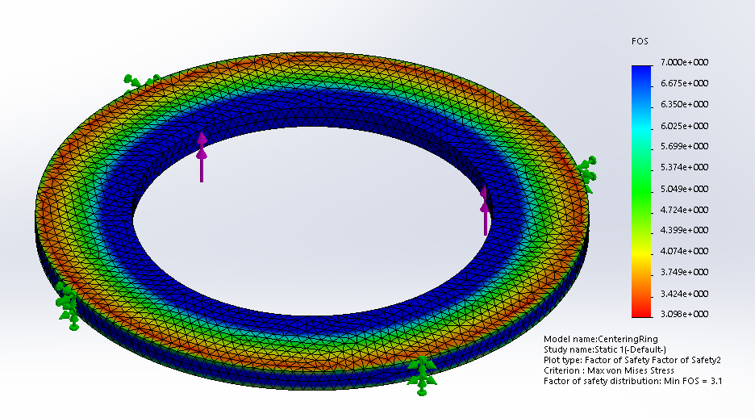
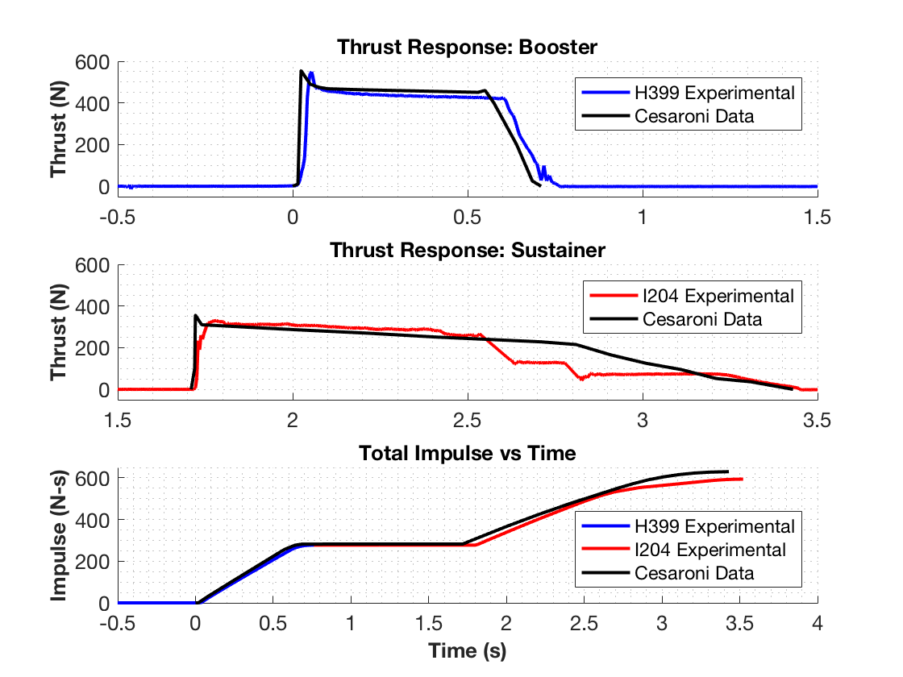
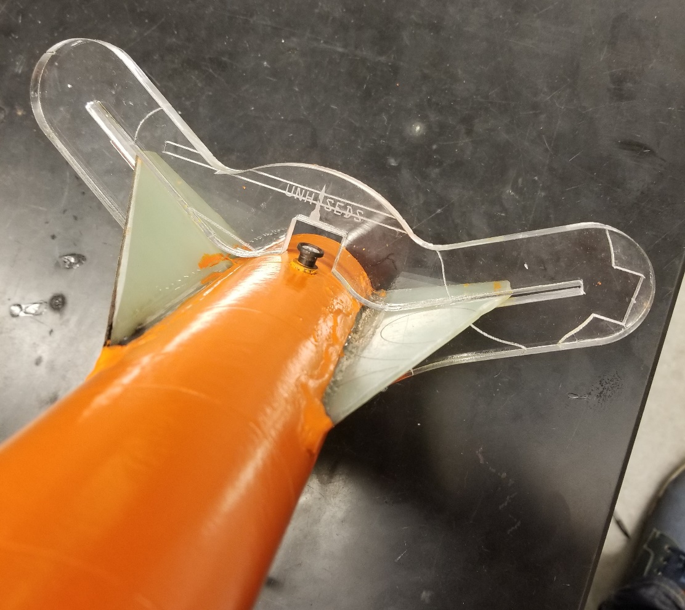
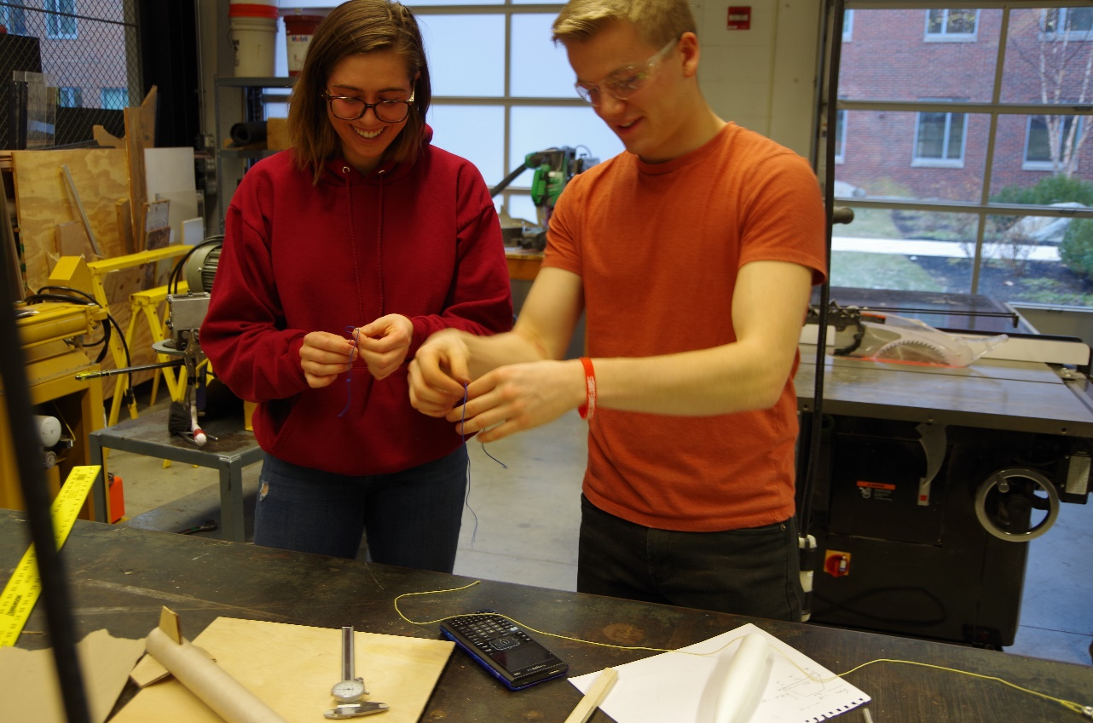
Department of Mechanical Engineering
Authors: Charlie Nitschelm, Kevin Bucher, Nick Clegg, Reilly Webb
Advisor: Dr. Todd Gross
Project Overview
To design, manufacture, and launch a high-powered, multi-stage rocket for the SEDS University Student Rocketry Competition
Goals
Design a high-powered engine class rocket to achieve maximum altitude
Implement a comprehensive recovery system that results in a fully reusable rocket
Constraints
Total combined engine impulse must not exceed 640.0 N-s
Must have at least two propulsion stages
Drogue Parachute
A small parachute deployed at sustainer apogee
Launch Simulation
Custom Nose Cone
A carbon fiber nose cone that houses the drogue parachute and connects directly to the electronics bay
Rocket trajectory was simulated using MATLAB. This required accurate stability, thrust, drag, and atmospheric models to produce ordinary differential equations that are then numerically solved for given rocket dimensions
Caliber is a measure of passive stability, and should remain between 1-3 for stable flight (right)
Electronics Bay
Houses the TeleMega GPS and controls both parachute deployment and sustainer ignition
Sustainer Parachute
A larger main parachute that
slows the sustainer to a safe landing speed
The MATLAB flight model is verified by comparing results to flight data from launches and to OpenRocket predictions (a pre-existing rocket simulation program)
 | Flight Data | OpenRocket Model | MATLAB Model
Sustainer Apogee | 1071.1 m | 1020.6 m | 1154.1 m
Booster Apogee | 290.0 m | 238.6 m | 276.3 m
Sustainer Engine
Propels the rocket to max altitude after booster burnout; 1.7 second burn time
Forward Fins
Provides stability to
the sustainer after stage separation
Check Integrity with Finite Element Analysis
Research Aerodynamic Theory
Optimize Rocket Dimensions
Staging Coupler
Supports stage separation at sustainer ignition
Manufacture and Assemble
Booster Parachute
A large parachute to slow the
booster to a safe landing speed
Improve
Aerodynamic Models
Rocket Improvement Cycle
Design & Analysis
An optimization program was created to determine the nominal dimensions for each component that will result in the highest simulated altitude.
An optimization program was created to determine the nominal dimensions for each component that will result in the highest simulated altitude
Launch and Gather Data
Booster Engine
Initiates flight with a
0.7 second burn time
Improve Manufacturing Techniques
Aft Fins
Provides stability to the rocket before stage separation
This was achieved by maximizing the height output from the combined aerodynamic models through nonlinear programming using the interior-point algorithm
Improve Field Launch Techniques
Propulsion
A Static Test Fire Rig was designed and manufactured to test the propulsion characteristics of each engine and to verify total engine impulse stays below 640.0 N-s
Optimization Constraints:
Maintain in-flight stability
Structural integrity factor of safety of at least 3.0
Manufacturing limitations
 | Reported Max Thrust | Measured Max Thrust | Reported Total Impulse | Measured Total Impulse
Booster Engine: Cesaroni H399 | 545.8 N | 549.6 N | 282.2 N-s | 277.1 N-s
Sustainer Engine: Cesaroni I204 | 356.8 N | 329.7 N | 347.7 N-s | 322.7 N-s
Manufacturing
Stress analyses are performed on the optimized components that are prone to failure, such as the engine centering ring (left)
A laser cut fin alignment tool was designed to keep fins in place during the epoxy curing process
Many components are assembled from scratch such as the nosecone, fins, ignition leads, ejection charges, and the launch pad
Data acquisition was performed using the custom test rig, a 150 lb load cell, and NI SignalExpress software
Results were verified by comparing to official data reported by the engine manufacturer
Optimization must be reconfigured if resulting FOS is less than 3.0
Acknowledgments
A huge thanks to all the members of UNH SEDS, Prof. Martin Wosnik, Alireza Ebadi, Thomas Collins, the Parents Association, and our advisor Todd Gross for all the support

